Slide 1
Music Rater (Melodi)
–
Status for 10/28/2024
Adrianna Bordonaro, Project Manager
adrianna.bordonaro1@marist.edu

Slide 2
Executive Summary
Complete: Following / becoming friends with other users
On schedule: Friends activity page, rating songs out of 10
In progress: N/A
At risk: N/A
Complete: FR1 User Profiles, user interface

Slide 3
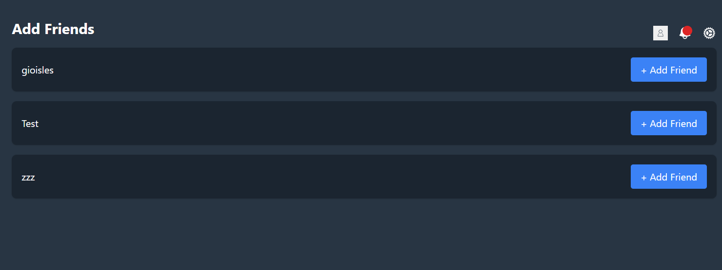
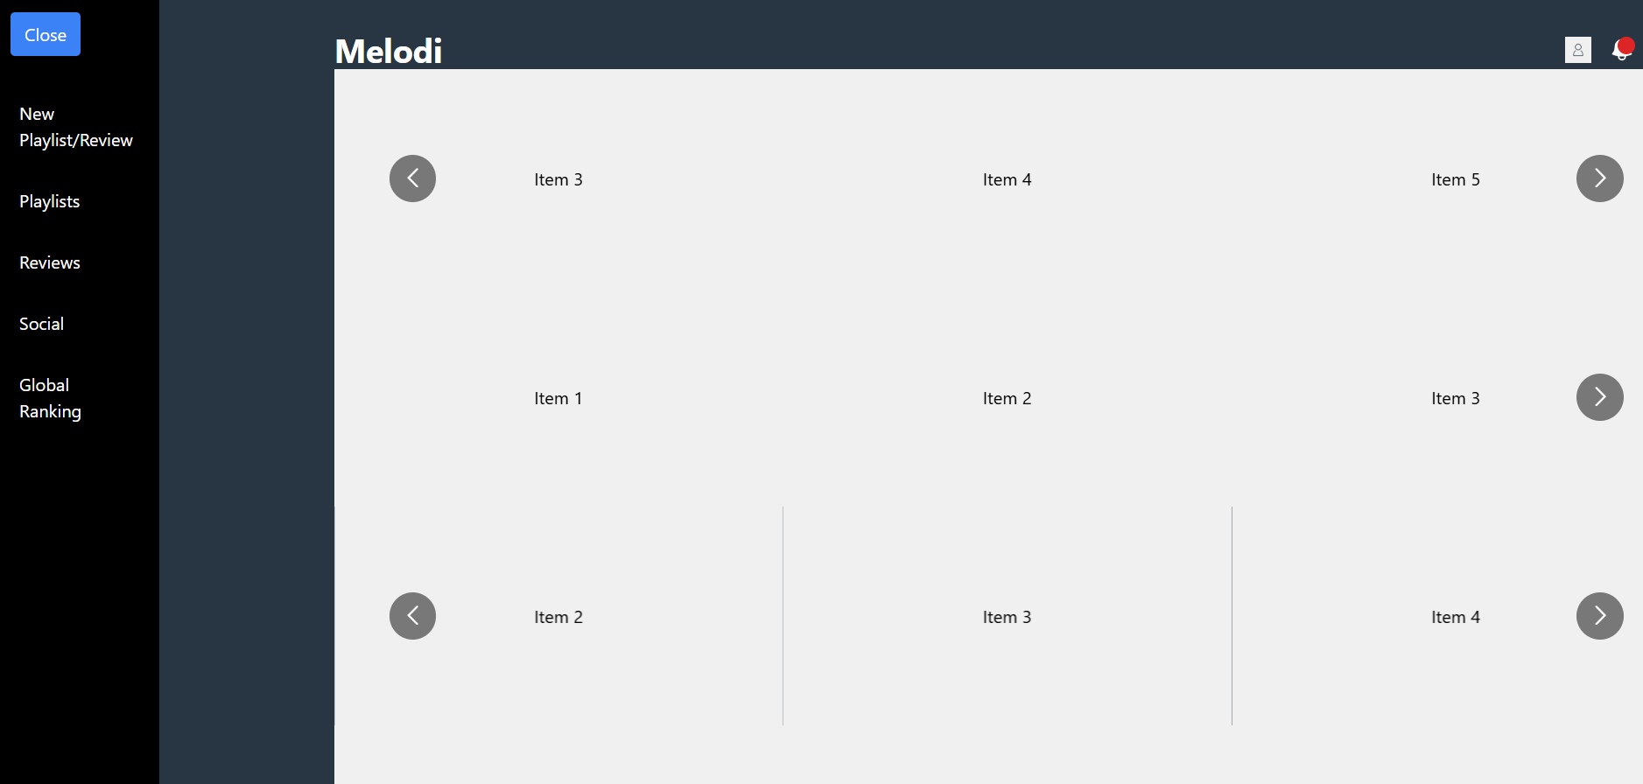
Status Details
Moving forward with other social functions such as an activity feed
Working on song rating functions (Spotify data)

Slide 4
Next Steps / Actions
FR2 (creating and sharing playlists)
FR3 (song ratings)
FR4 (friends and social activity)
Many features to go but thankfully they are not linear or overly interdependent

Slide 5
Thank you
Questions?

